Slide 1
DS 203
Assignment E7
22b0321 : Aman Kumar Singh
22b0326 : Pratyush Ranjan
22b0432 : Sarthak Mishra
22b2525 : Samyak Pahade

Slide 2
Streamlining Architectural Design with Data Science
We are given 1183 bitmap images of building layouts, each 640 x 480 pixels.
We have to analyze these images to identify design families, classify the complexity of layouts, and develop a system to retrieve designs based on specific parameters. We also have to explore ways to use this data to enhance design processes and productivity which will save a lot of time and effort.
Methods: Image Feature Detection algorithms such as Convolutional Neural Network (CNN), Clustering algorithms such as K-Means

Slide 3
1 - Objectives
2 - Steps
3 - Approach
4 - Alternative
5 - Challenges
6 - ML Models
7 - Key Learnings
Table of contents

Slide 4
Objectives
Design Family Clustering
Complexity Classification
Categorize building layouts into shape-based families
Analyze layouts to establish complexity criteria as Low Complexity, Medium Complexity, High
Complex
and automate their classification through machine learning.

Slide 5
Objectives
Design Retrieval
Exploring Data Utilization
Develop a system to match architects’ parameters such as dimensions, the layout area, and the permissible layout complexity
with relevant designs for efficient retrieval and future use
Explore other uses of image data, like trend prediction and design optimization

Slide 6
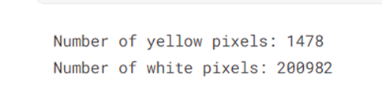
Steps
1
Preprocessing
At first, we preprocessed images to detect yellow and white pixels.
On checking pixel count for 1181.jpg we get:
Basic Libraries:
numpy
cv2
matplotlib

Slide 7
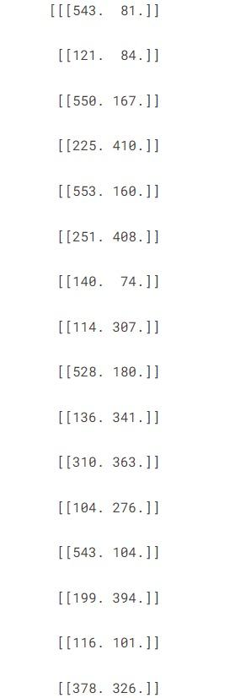
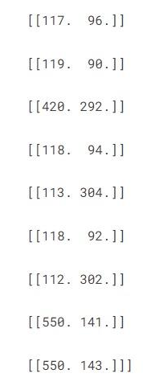
Steps
1
Preprocessing
Then, we preprocessed some images to determine the number of edges and corners.
After implementing Canny corner detection code to extract corner coordinates from the image, our output was:

Slide 8
1
Preprocessing
Inferences
Problems
The count of these points perfectly matched when we manually counted the edges. We performed similar counts for various other images as well.
We tried two different ways, Gabor filtering and Canny edge detection, to count the edges, but no matter how we adjusted the settings, we couldn't get accurate results.

Slide 9
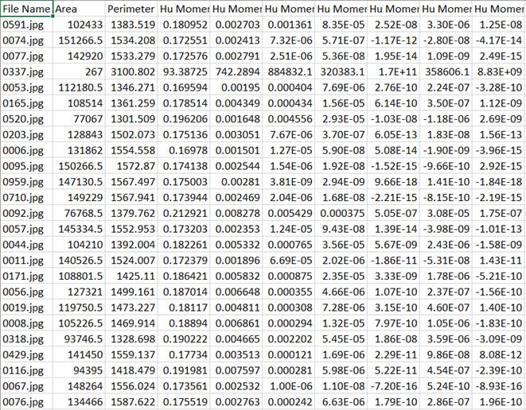
Steps
2
Features Extraction
We extracted features such as 7 Hu Moments, Area, and Perimeter of the image. These features serve as the basis for performing K-Means Clustering

Slide 10
Hu Moments
Hu Moments consist of seven scalar values derived from the central moments of an image.
Hu Moments are used in image processing and computer vision for shape analysis and recognition.
Central moments describe the distribution of intensity values within an image.
Hu Moments provide scale, rotation, and translation invariant features for characterizing object shapes.
They ensure robustness across different image conditions.
Hu Moments are commonly used in pattern recognition tasks such as object recognition, shape matching, and image retrieval.

Slide 11
Steps
3
k-means clustering
We initiated the k-means clustering algorithm to identify the maximum number of distinct clusters.
While executing, a warning from the sklearn library alerted us about the limit on the maximum number of clusters that k-means can generate.
In the first iteration, we observed a maximum of six clusters.

Slide 12
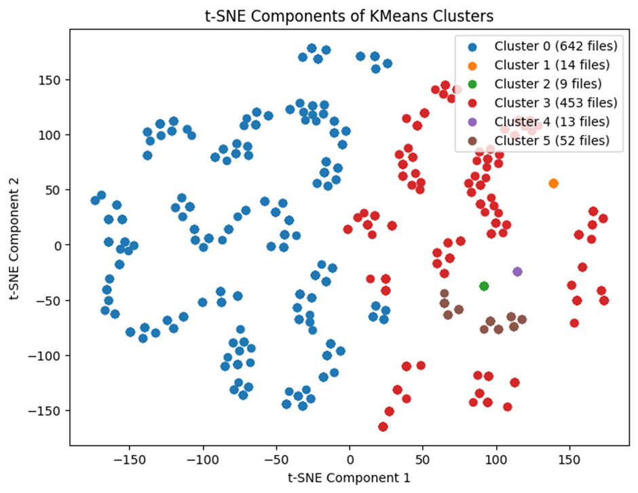
Steps
4
t-SNE visualization
We then employed t-SNE visualization to assess the clustering of images and the distribution of images within each cluster.
Upon observing the graph, we notice that not all points are visible; it appears that some points are overlapping.

Slide 13
Steps
5
Identifying distinct Clusters
We re-ran k-means clustering on cluster 0 to identify the maximum number of distinct clusters.
This time, we observed 100 distinct clusters, which appeared to be abnormal clustering behavior.
To address this issue, we opted to categorize the images based on their clustering labels.
We created subfolders for each cluster label and sorted images accordingly.
Upon manual inspection of the 100 clusters within cluster 0, we found that each cluster comprised duplicate images.
Each cluster contained approximately 7-8 identical images.

Slide 14
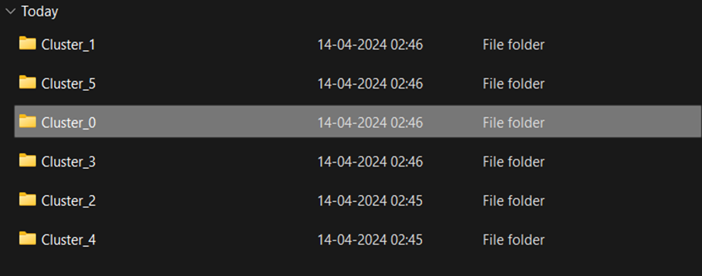
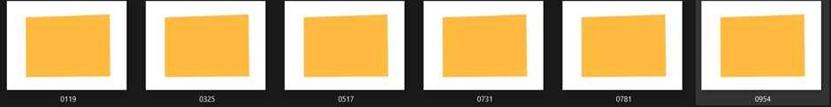
Steps
5
Identifying distinct Clusters
On opening cluster_0 we get approx. 100 clusters subfolders.
Then opening the subfolder for Cluster_20, the images appear as follows:
We can see that the images are exactly identical.

Slide 15
Steps
6
Removing duplicate images
Initially, we decided to remove all duplicate images before re-running the k-means clustering algorithm.
This process involves file hashing using SHA-256, where each image file in a directory receives a unique cryptographic hash.
The hash is computed based on the content of the file, ensuring that files with identical content produce identical hash values.

Slide 16
SHA - 256 algorithm
The SHA-256 algorithm, part of the SHA-2 family, generates a 256-bit hash, providing a high level of uniqueness.
By utilizing SHA-256 hashing, duplicate images can be efficiently identified solely based on their content, rather than relying on potentially unreliable factors like filenames or metadata.
This method is robust and widely used for identifying duplicates across various types of files.

Slide 17
6
Removing duplicate images
Dictionary Created
Inferences
We've created a dictionary associating each image name with its corresponding hash value, computed using the SHA-256 algorithm. Subsequently, we eliminated all duplicates sharing the same hash value.
Following the removal of duplicate images, our count decreased significantly from 1183 to just 173 images.
Given the low number of images remaining, we opted not to downscale them to lower resolutions.

Slide 18
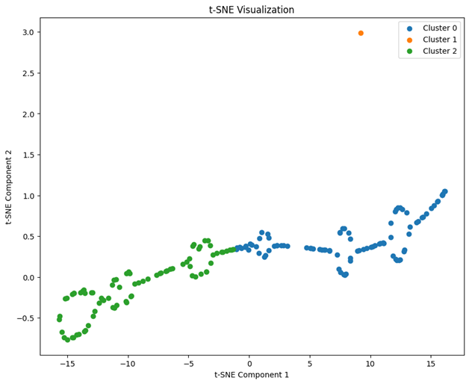
Steps
Complexity Classification
7
To categorize images based on complexity (High, Low, and Medium), we set the desired clusters to 3. Below is the t-SNE plot depicting the results.
During the k-means clustering process on these images, we discovered that the maximum limit of clusters was 173, determined by features such as Hu moments, Area, and Perimeter of the image.
Silhouette Score: 0.6062498542605892
Davies-Bouldin Score: 0.3150324624909610
Cluster 0: 98
Cluster 1: 1
Cluster 2: 74

Slide 19
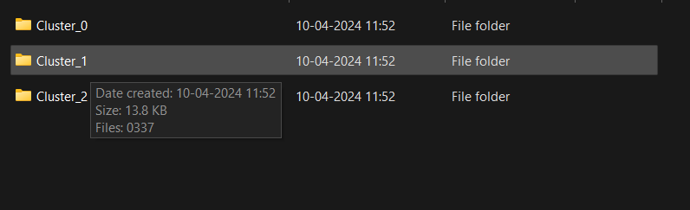
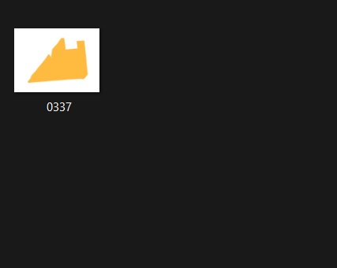
Though the scores like Davis Bouldin and Silhouette Score were pretty good for above type of cluster, we again went on manually checking what images goes into these clusters. On checking we found that only one image was present in one of the cluster.
Silhouette Score
Davies-Bouldin Score
Silhouette Score: This metric ranges from -1 to 1.
A score closer to 1 suggests that the samples are distant from neighboring clusters.
Conversely, a score closer to -1 indicates proximity to neighboring clusters.
A score around 0 suggests overlapping clusters.
The Davies-Bouldin score evaluates the average similarity between clusters.
It measures the average similarity of each cluster with its most similar cluster.
The score ranges from 0 to positive infinity.
A lower Davies-Bouldin score indicates better clustering performance.
A score of 0 represents the best possible outcome.

Slide 20
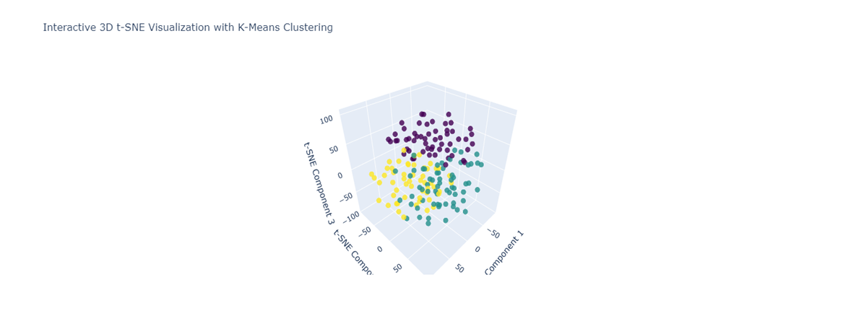
Steps
8
Manual Checking for Classification
Though the scores like Davis Bouldin and Silhouette Score were pretty good for this type of cluster, we again went on manually checking what images goes into these clusters. On checking we found that only one image was present in the cluster.
Silhouette Score: 0.15934951603412628
Davies-Bouldin Score: 3.6421174240769894
Cluster 0(Medium): 25
Cluster 1(High): 75
Cluster 2(Low): 73
We label these clusters as low, medium and high by manual inspection

Slide 21
Steps
9
Using CNN for Classification
We attempted to enhance our image features by employing Convolutional Neural Networks (CNN).
Transfer learning was utilized to load a pre-trained CNN model, with certain layers excluded to focus on detecting edges and corners.
Features extracted from CNN appeared more abstract compared to previous methods, attributed to the tensor outputs containing numerous numerical values.
Subsequently, features were extracted using this approach and used for K-Means clustering with three desired clusters.

Slide 22
Results
9
Using CNN for Classification
Upon manual inspection, a more balanced distribution of images was observed.
However, the clustering scores of Silhouette and Davies-Bouldin were lower when utilizing CNN-based features.
This was primarily due to the difficulty in classifying some images into High, Medium, and Low complexity ranges.

Slide 23
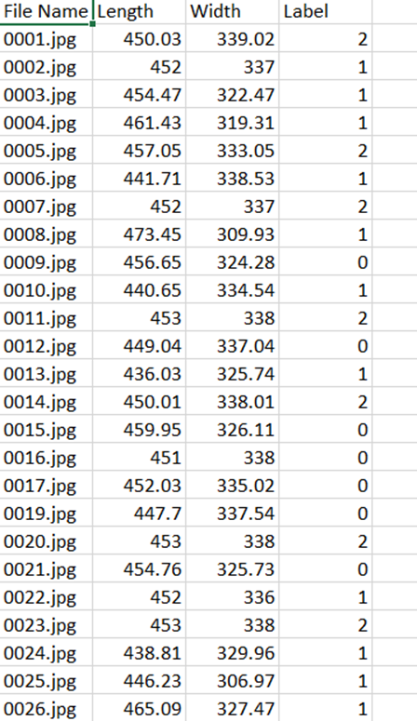
Steps
10
Tight fitting Box
We incorporated a code to measure the dimensions of a tight-fitting box. Now, when the user provides input such as the box length, box width, and complexity label, the system displays the corresponding images in the next slides.
Since features extracted from CNN are very abstract we have directly created csv file as shown .

Slide 24
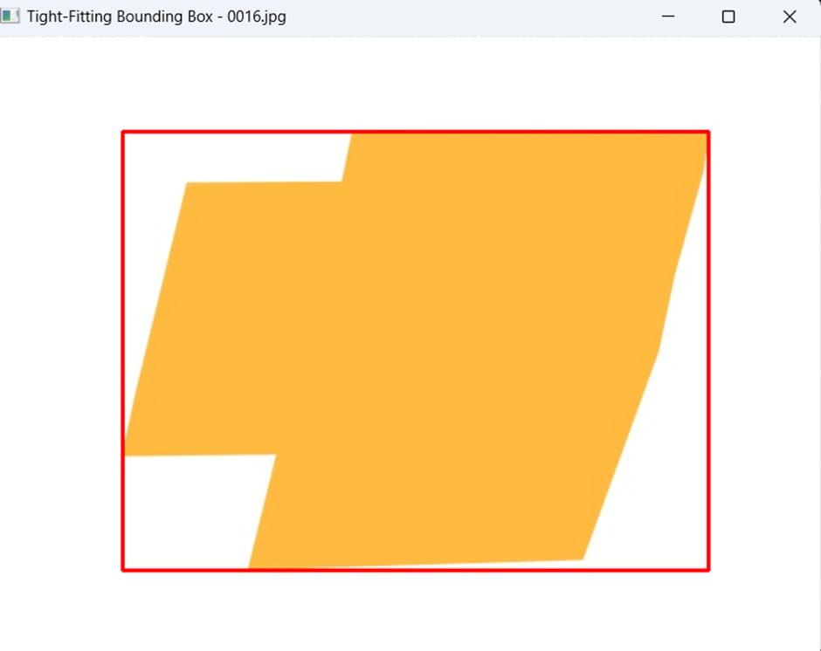
Examples
10
Tight fitting Box
Input:
Length: 451.0
Width : 338.0
Complexity: 0

Slide 25
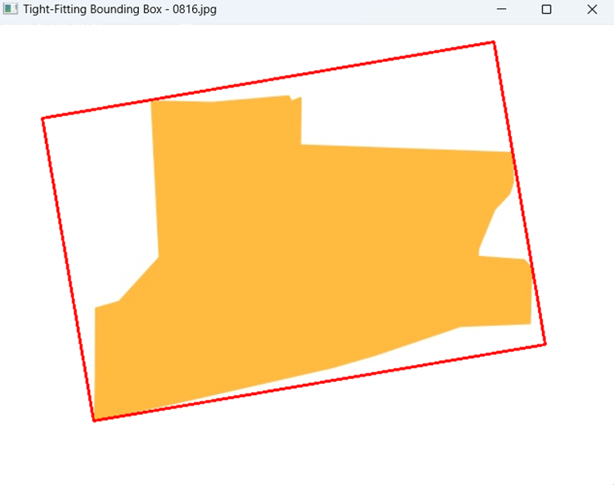
Examples
10
Tight fitting Box
Input:
Length: 472.65
Width : 317.46
Complexity: 1

Slide 26
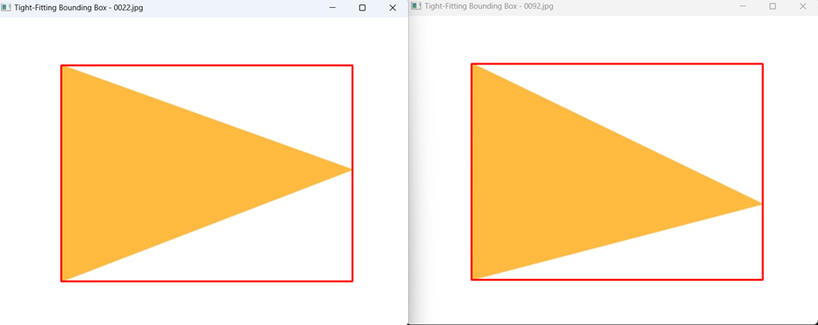
Examples
10
Tight fitting Box
Input:
Length: 452 Width : 336 Complexity: 1

Slide 27
Summary
Preprocessing Techniques:
We started by identifying yellow and white pixels in images, a critical step in our image analysis process. This allowed us to gauge the distribution of these specific colors within our image set.
Edge and Corner Detection: We employed Canny corner detection to pinpoint the corners within the images. The accuracy of this method was validated when the count of these points matched our manual counts.
t-SNE Visualization:
To visualize our clustering, we utilized t-SNE. The overlapping of some points indicated that not all clusters were distinct, a valuable insight for our analysis.
Feature Extraction for Clustering: Due to the issues with edge counting, we extracted features such as the 7 Hu Moments and the area and perimeter of the images. These features proved crucial for effective K-Means Clustering.

Slide 28
Summary
We identified and removed duplicate images using SHA-256 hashing, which not only ensured the accuracy of our analysis but also significantly reduced our image count, influencing our data processing decisions.
After removing duplicates and cleaning our dataset, our K-Means clustering became more representative of image complexity, and while the silhouette and Davies-Bouldin scores indicated quality clustering, but we still conducted manual inspections for verification.
Final Clustering and Labeling:
In the final phase, we labeled clusters as low, medium, or high complexity based on manual inspection.
CNN for Feature Extraction:
Our team utilized a Convolutional Neural Network (CNN) with transfer learning for feature extraction. This approach yielded more abstract features and improved the results of our manual inspections.

Slide 29
Important Note
We ran all the code files in Kaggle environment since many of the codes require image processing and using GPU was needed. So we have created all the files and downloaded those locally to check the nature of clusters. So in the zip file we may have some subdirectories
just for representation of codes ran. We were unable to run all the codes locally due to computational constraints and hence our csv files for some models were not created. And since we are creating folders on the basis of these csv files, we are unable to execute some codes with the data files kept the same directory.
However we have included all possible intermediate input data files containing feature information after feature engineering, or output files resulting from analysis or model executions.
We have at last used features which were extracted with CNN since on manual inspection the low, medium and high complexity image were better distributed than the features of Area, Perimeter and Hu Moments. And we have also further used the labels given by features of CNN to take input from user to speed up his layout finding process.

Slide 30
Program Flow
Run preprocessing.ipynb file to perform all the preprocessing as stated in the slides
Then run k-means-1.ipynb to see what was the behaviour of clustering when we ran it directly on the 1183 images.
To remove duplicate images and store all the unique images in the separate folder, we use the code for remove_duplicates.py
Then we can see the comparison of two features where we used features by running CNN and by extracting features of each image like Perimeter,Area,Hu moments of contour. It is achieved by running k-means-2.ipynb
To manually inspect what type of images are clustered by using two features ,we first create two csv files named image_cluster_labels.csv and image_features_with_labels_KMeans.csv . Then we use these two csv files to create subdirectories of clusters using the code written in Cluster_with_CNN.py and Cluster_with_Kmeans.py
Now we use code of tight_fitALL.py to create features of length and width of tight-fitting box of all images into a csv file.
We merge the above created csv file with the labels of images as obtained from using features(extracted from CNN) using the code in csv_merge.py which then creates the file merged_csvCNN.csv; Now we use this CSV file for searching the image, when the user inputs the length,width of tight-fitting box and the complexity of image expected. Then user can see all the possible images with required specifications.

Slide 31
Intermediate Outputs
E7-Images_173 consist of all the subfolders E7-images(via CNN) and E7-images(via k-means) which then have subfolders representing the 3 clusters as achieved by code described above
E7-images_Unique have all the 173 images after removing all the duplicates
E7-images_1183 consist of a subfolder resized_images and two csv files named image_features_with_labels.csv which represent labels of all the images. Using this csv file we have created 6 subfolders in resized_images subfolder. Now the image_features_with_labels_Cluster_0.csv is created when we run k-means on cluster_0 in resized_images/Cluster_0. Then we get 100 clusters within cluster_0. We create those 100 subfolders using the csv file of image_features_with_labels_Cluster_0.
Image_cluster_labels.csv represents labels corresponding to file names when we use features which were extracted through CNN.
image_features_with_labels_KMeans.csv represents all the features of Area,Perimeter,Hu Moments and label associated with 173 unique images
image_features.csv represents the Length,Width of tight fitting box of all images.
merged_csvCNN.csv is the combined features from two csv files of image_features.csv and Image_cluster_labels.csv

Slide 32
Thank you!

